Slide 1
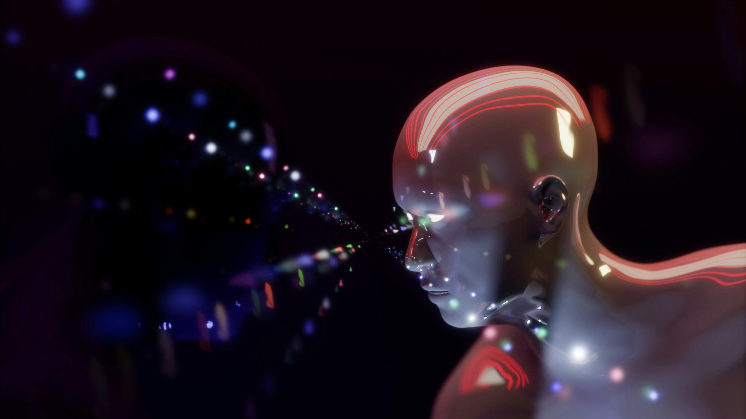
Class portfolio
Sha'Rise Griggs - "Computer Vision Artificial Intelligence -13788 December 11,2024 - Link https://github.com/stauriea21/ITAI1378_Computer_Vision_Portfolio.2
ThePhoto by PhotoAuthor is licensed under CCYYSA.

Slide 2
What was this course about
In this class, we explored the basics of computer vision, which included techniques like recognizing objects in images and building machine learning models. We worked on practical projects, from manipulating images to understanding how machines "see" the world
.My Personal Goals I wanted to get comfortable using computer vision tools like Open CV and Tensor Flow. I also aimed to build models that could solve real-world problems, like identifying objects or classifying images correctly class Experience. The class was hands-on, and I enjoyed experimenting with code to see how changes impacted the results. It was exciting to learn how concepts like neural networks and image processing come together in real applications.

Slide 3
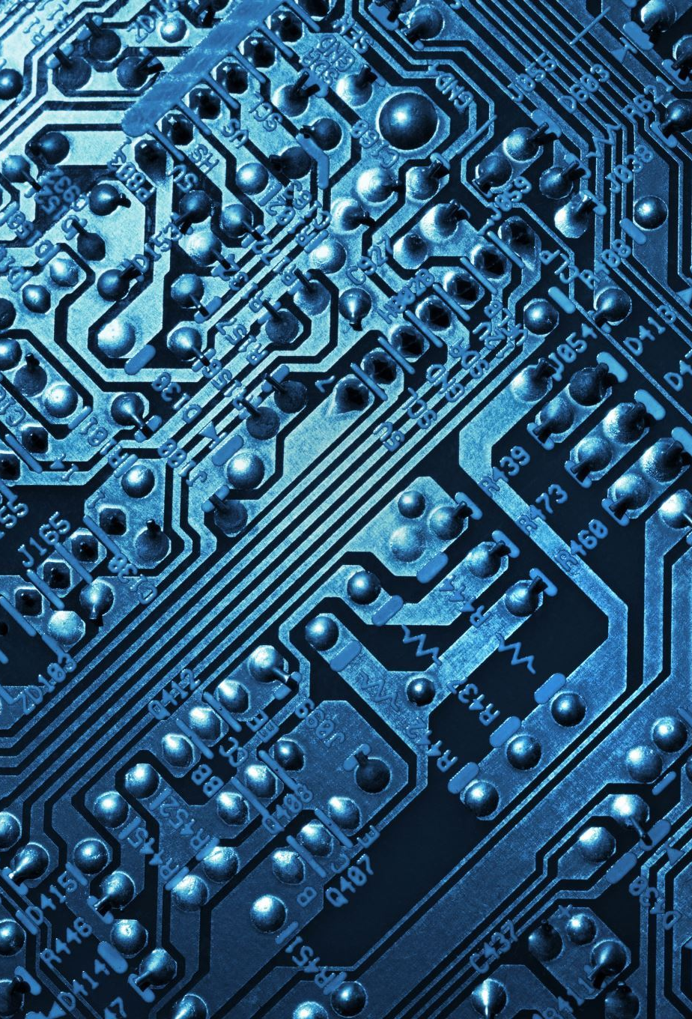
My learning journey
Brief introduction to the portfolio: - This portfolio showcases my learning journey in the Computer Vision course, including projects, reflections, and practical applications.
,Classification with SVM. Image Classification
Convolutional Neural Networks (CNNs)
Image Processing.
Object Detection
Used transfer learning and the Pascal VOC 207 dataset to learn more about applying it on our
Proficiency in Python, GitHub for version control, and computer vision libraries like OpenCV and TensorFlow.

Slide 4

Course overiew
This course explored various computer vision techniques and concepts across 12 modules.
Topics included Convolutional Neural Networks (CNNs), Object Detection, Image Classification, and Transfer Learning.
Tools and Technologies Used:
Python for programming tasks.
Libraries like OpenCV and TensorFlow for implementing computer vision projects.
GitHub for managing and sharing code.
The skills I gained understanding foundational AI concepts applied to computer vision.
Building and evaluating models for real-world applications.

Slide 5

Moduel 1-2 TIMELINE
Modules 1 & 2 In this module, we worked on the introduction of computer vision. It was very important to learn, because we got to understand how crucial this subject really was in the field of Artificial Intelligence.
we also worked on Exploring the Real-World applications of Computer Vision (CV). We also got to learn about the History and Timeline of Computer Vision.

Slide 6
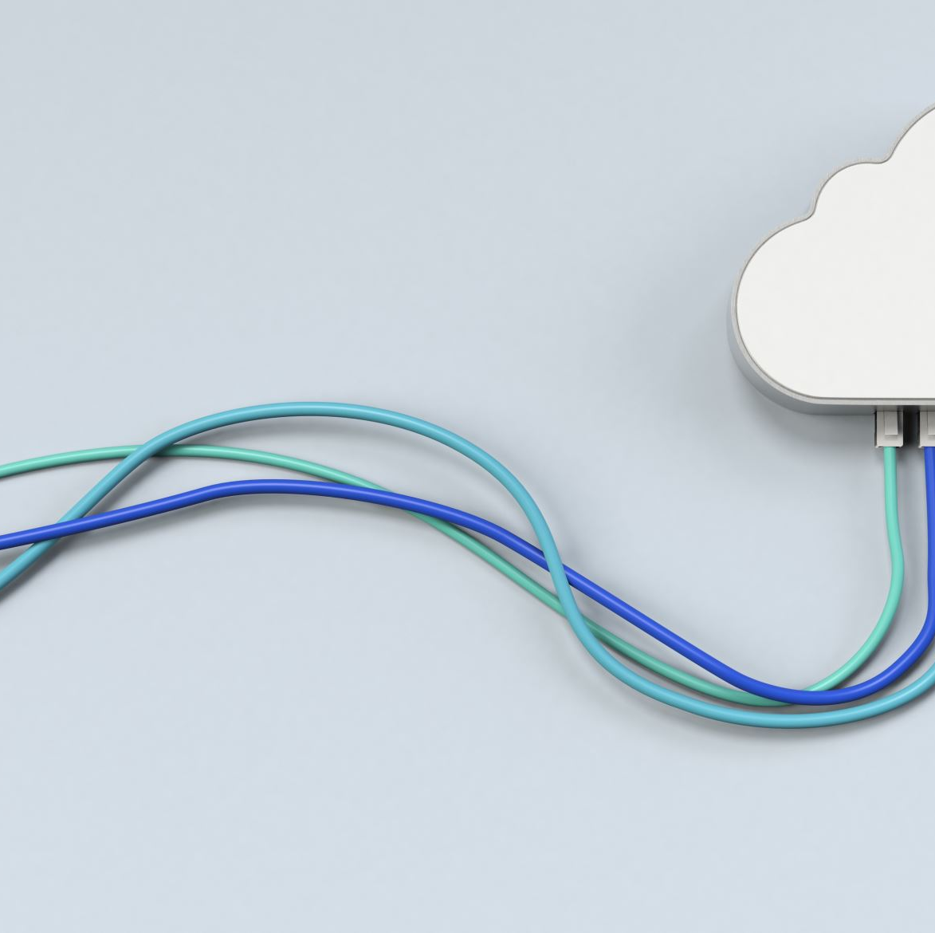
Moduel 3 & 4 TOOLs AND PLATFORMS WE LEARNED
Jupyter Notebook: A versatile tool for writing and running Python code, ideal for data analysis and machine learning experiments.
Google Colab: A cloud-based platform for coding and collaborating, offering free GPU resources for machine learning tasks.
AWS (Amazon Web Services): A powerful cloud service platform providing scalable computing resources for data storage and processing.
GitHub: A collaborative platform for version control and sharing code, essential for teamwork in programming projects.

Slide 7
Key Moduels 5, 6 & 7
**Highlighted** Image Classification with SVM. Image Classification is about the ability of a machine being able to classify different images into different categories.
Built an object detection model with ~85% accuracy. -
Gained insights into bounding box adjustments and performance evaluation. 2.
**Image Classification Using CNNs:** -
Developed a CNN model to classify images from CIFAR-10 dataset. -
Explored the architecture and performance analysis of CNNs compared to traditional neural networks. 3.
**Transfer Learning:** - Leveraged pre-trained models for efficient training on limited data. -
Applied to real-world datasets like VOC2007.

Slide 8
MODUEL 9 OBJECT DETECTION
We worked on another group assignment, but this time it was about Object Detection and how there are many different ways it is being used nowadays. Object Detection is used in our everyday lives and it is now more important to understand than it ever has been before because of the pace technology is advancing at. Used transfer learning and the Pascal VOC 207 dataset to learn more about applying it on our own.

Slide 9
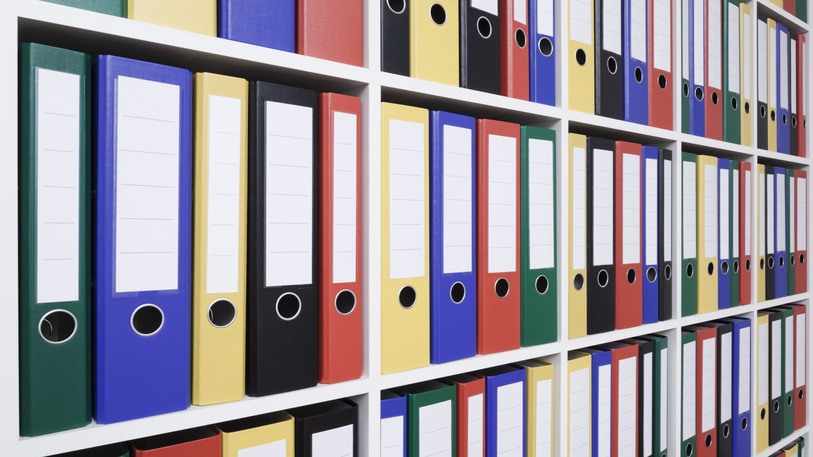
DATA SETS AND dOCUMENTIONS AND tUTORIALS
Title: CIFAR-10 Dataset, PASCAL VOC 2007 DATASET
Provided the foundational data for image classification tasks in the course.
Documentation and Tutorials:
Title: TensorFlow Documentation https://www.tensorflow.org/
Guided me through setting up and implementing machine learning models efficiently.

Slide 10
Reflections and resources
**Personal Insights: - This course deepened my understanding of computer vision concepts and improved my technical skills. -
Challenges included managing large datasets and troubleshooting model performance issues. -
**Challenges Overcome:** - Learned effective debugging techniques and efficient dataset management strategies. -
Key Resources:
1. Article: “Understanding YOLO” – Provided insights into real-time object detection.
2. Video: “Deep Learning for Computer Vision” – Explained core concepts and applications.
3. Tutorials: Guided steps for working with TensorFlow and OpenCV.

Slide 11
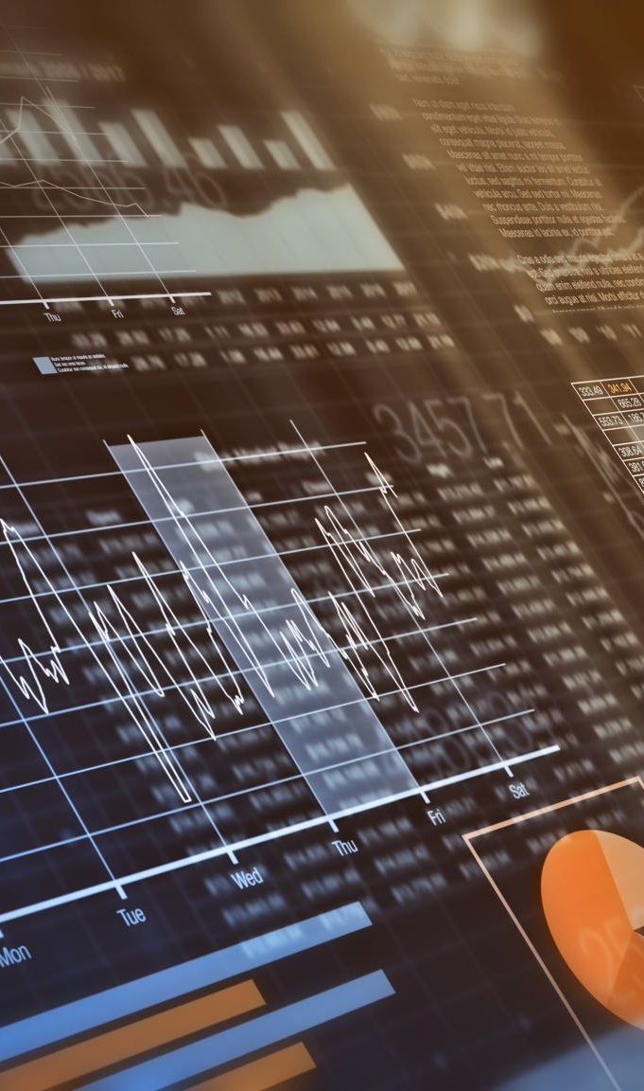
Final Thoughts and Future Plans
**Summary of Learning Journey:**
I Gained hands-on experience with cutting-edge computer vision tools and techniques. -
Learned to apply theoretical knowledge to solve practical problems. -
**Future Plans:** -
Explore generative AI and autonomous systems in computer vision. -
Pursue internships or projects to deepen my expertise. -
"Thank you for reviewing my portfolio!" - **GitHub Repository Link:** - Add as a QR code for easy access. -
** - “The best way to predict the future is to invent it.” – Alan Kay

Slide 12
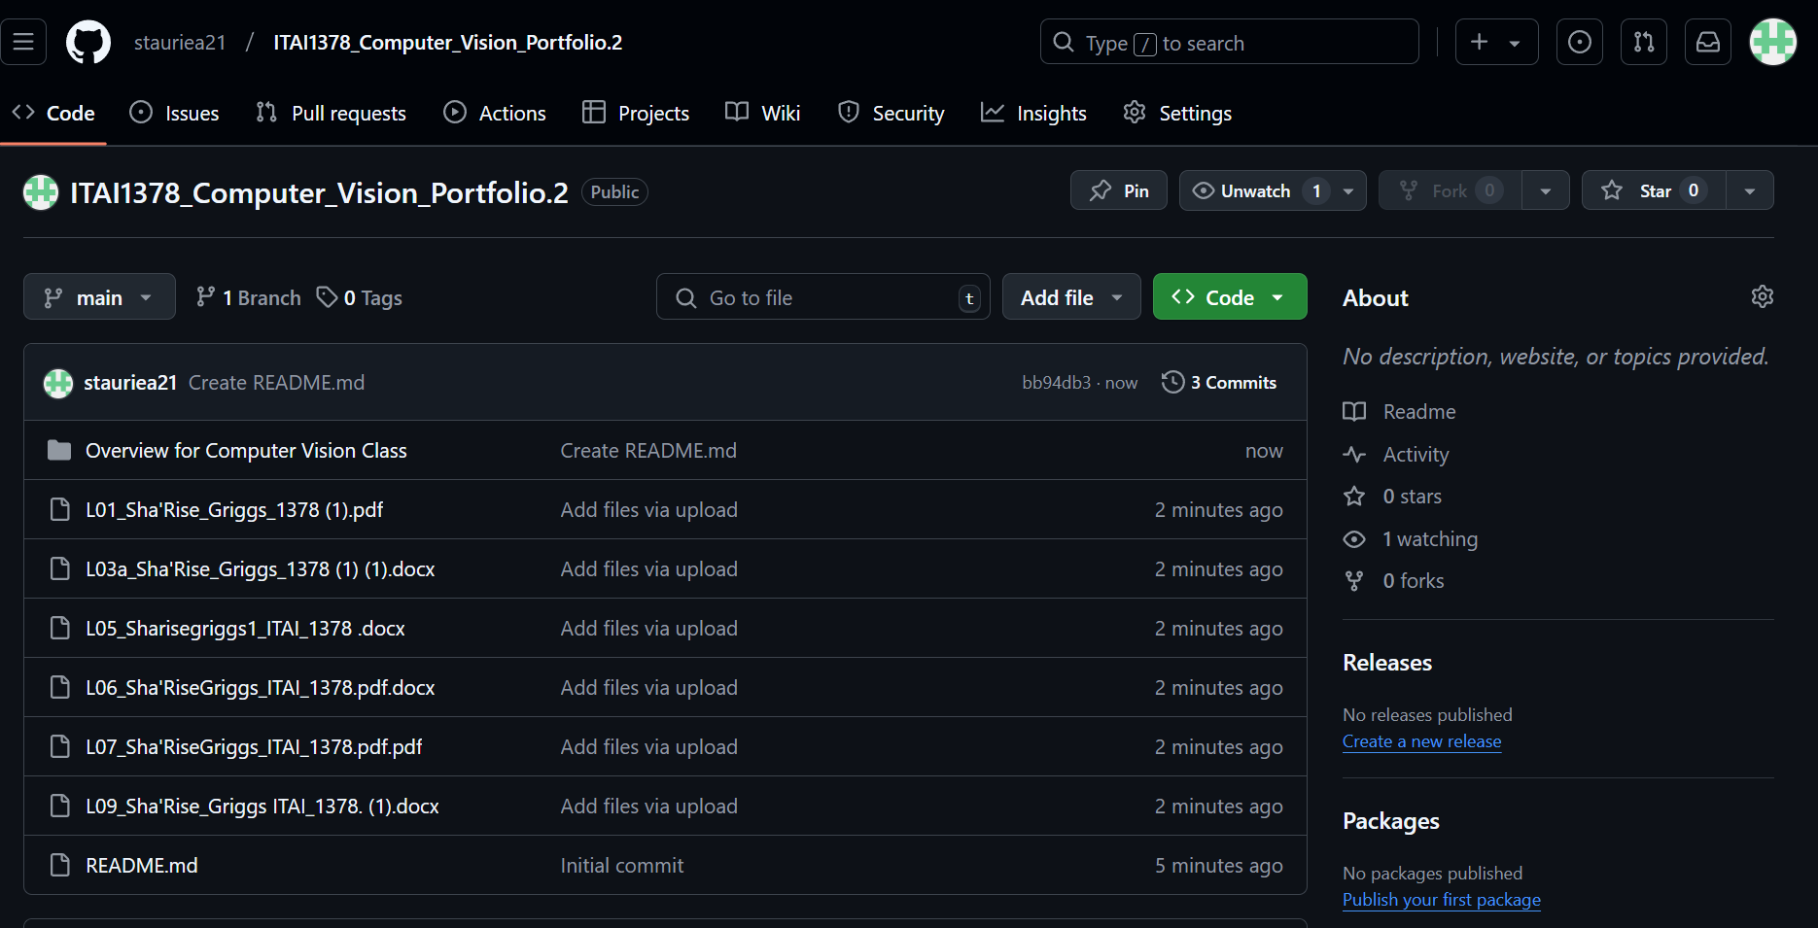
Github rEPOSTIORY
https://github.com/stauriea21/ITAI1378_Computer_Vision_Portfolio.2

Slide 13
KEY rESOURCES
* 1. **Article:** "Understanding YOLO for Object Detection" - [Author Unknown]. (2021). *Towards Data Science*. Retrieved from https://towardsdatascience.com/understanding-yolo-object-detection-75175b6dc3c3
2. **Video:** "Deep Learning for Computer Vision" - Stanford University. (2021). *YouTube*.
https://www.youtube.com/watch?v=oJNHXPsNOe8
3. **GitHub Repository:** TensorFlow Object Detection API - Google Research. (2024). *GitHub*. https://github.com/tensorflow/models/tree/master/research/object_detection
4. **Dataset:** CIFAR-10 Dataset - Krizhevsky, A. (2009). *Canadian Institute for Advanced Research*. https://www.cs.toronto.edu/~kriz/cifar.html
5. **Documentation:** TensorFlow Official Guide - TensorFlow. (2024). *TensorFlow Documentation*. https://www.tensorflow.org/

Slide 14
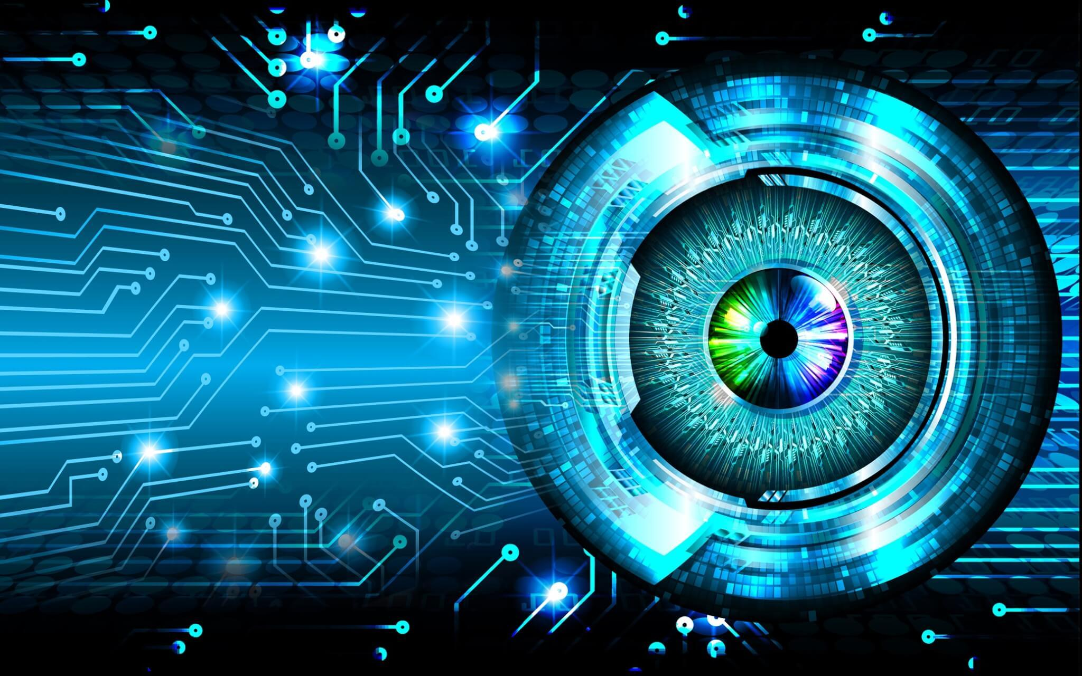
COMPUTER PORTFOLIO

